Slide 1
Module 3
Building a web app

Slide 2
Contents
Objective:
Get a basic understanding of how one would try to build a webapp
Topics:
Recap
Domain names
Hosting
Web application code
Deploying application code

Slide 3
Building a webapp...
Web server
Browser
(web client)
Network
response
Computer (host)
request
DNS helps convert domain name to IP
This is what we need to set up, to serve our own webapp

Slide 4
Build a webapp that others can use?
Building a webapp involves the following steps:
Get a unique domain name
So that people can remember your webapp so that they can reach it.
Set up a computer with an IP to serve the webapp
Link the domain name with the server’s IP address.
Write your application code (web server)
Deploy your application code on the computer that is your server host

Slide 5
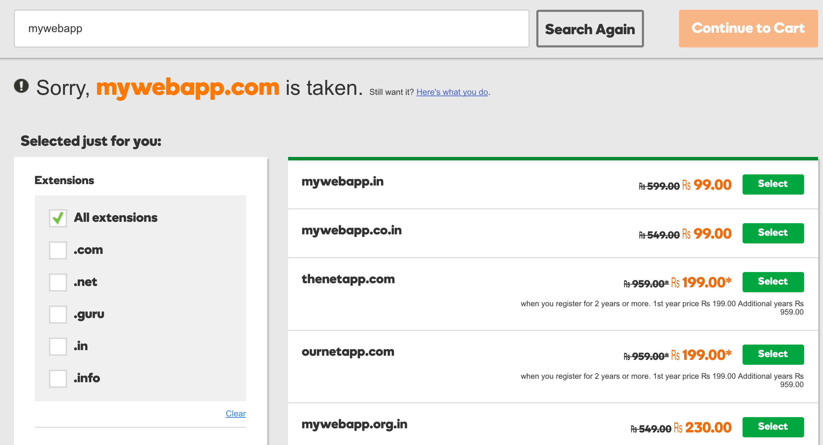
3.1 Get a domain name
Get a domain name so that people can reach our web app.
Buy a domain name using domain registrars.
Registrars take your domain name and make sure that no-one else, including other registrars can use that name while you have it.
Some popular domain registrars:
gandi.net
godaddy.com
name.com
Notes:
Screenshot from godaddy

Slide 6
Web server
Browser
(web client)
Network
response
Computer (host)
request
DNS helps convert domain name to IP
✔

Slide 7
3.2 Set up a web server - I
We need to get a computer and a unique IP.
Option 1: (super hard!)
Buy a computer
Connect it to your ISP
Get a unique IP for your computer that won’t change
Install your OS and web server software
Option 2:
Rent a computer from a vendor somewhere else in the world.
Vendor provides the IP with which you can reach your computer.

Slide 8
3.2 Set up a web server - II
The technical term for renting computational power from a vendor: hosting
Many different types of hosting
1. Shared hosting:
Many different users are created on the same computer (the same as creating multiple users on your own computers)
Users have to share CPU, RAM and disk resources.
All users get the same IP.
3. VPS hosting
Virtual Private Servers are virtual machines created on the same physical machine. You get a dedicated IP.
Pros: Less expensive than dedicated hosting
Cons: Lower performance than dedicated hosting
4. Cloud hosting
Similar to VPS providers but allow for rapidly changing size of the virtual machine and provisioning more machines on the go.
Quick exercise: For each of the below, find out what kind of hosting they offer?
webfaction, godaddy, Google Cloud Platform, bluehost, AWS, softlayer, linode, digitalocean, Rackspace
2. Dedicated hosting:
You can rent a machine that only you get to use. No other users get access to that machine.
You get a dedicated IP that is unique to you.

Slide 9
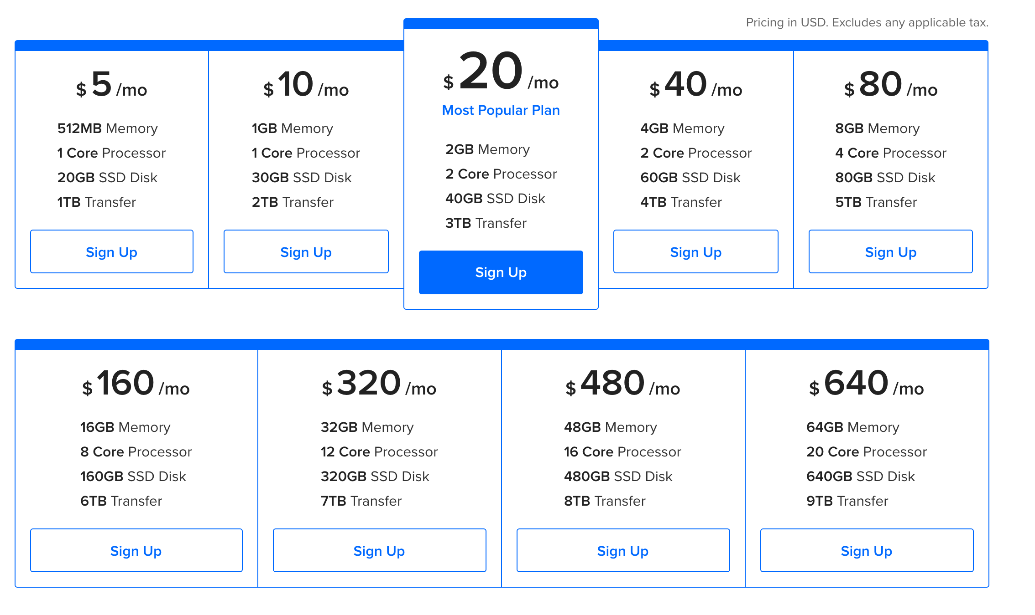
3.2 Set up a web server - III
The experience of buying or renting a computer.

Slide 10
3.3 Link domain name to the server
Next, you map the domain name to this IP
This information is published by the registrar on their DNS servers so that anyone in the world can now exchange your domain name for the IP
You can access a webserver using its domain name or its IP.
ex: http://nptel.ac.in/ is the same as http://14.139.160.71/
My Server
IP
mydomain.com

Slide 11
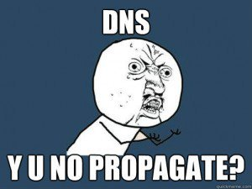
3.3 DNS propagation
What happens when you set the IP for a domain?
The DNS system is a globally distributed database of domain-name to IP mappings maintained by many name servers spread over the Internet.
When you update the domain-name to IP mapping with your registrar a gradual wave of updates begins and DNS can take upto 48 hours to update worldwide!
Notes:
Image source: https://pbs.twimg.com/media/ClkNsrGUoAAvnQN.jpg

Slide 12
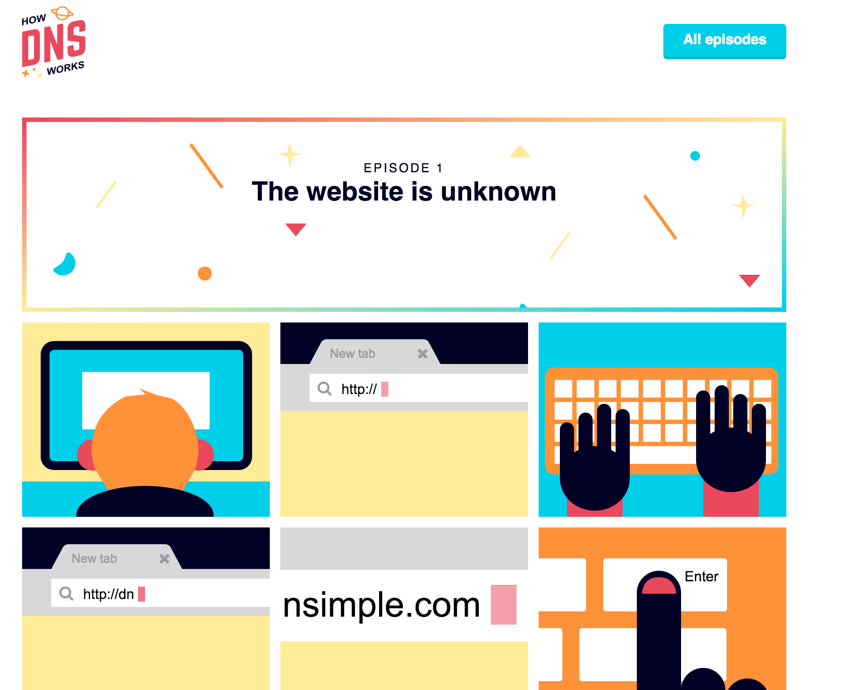
Understand DNS in more detail!
https://howdns.works/

Slide 13
3.4 Write application code
Web server
Browser
(web client)
Network
response
Computer (host)
request

Slide 14
3.4 Write application code
Write or install a program in your favourite language that can listen to a request and respond with appropriate information. This is the web server that will serve your webapp.
Listen on the network
Accept a request
Process the request
Output a response in a format that the browser will understand
Send the response back over the same connection on the network

Slide 15
3.4 Write application code
Writing a program that knows how to listen on a network is quite hard
Developers use several frameworks, libraries and tools that help them write only portions specific to their application and avoid the complex bits.
Listen on the network
Accept a request
Process the request
Output a response in a format that the browser will understand
Send the response back over the same connection on the network
Apache + Linux
Common “stacks” & frameworks that developers use:
LAMP: Linux Apache MySQL PHP.
WAMP, MEAN, Django, Rails, Laravel, Express
PHP + MySQL
Apache + Linux

Slide 16
3.5 Deploy code on your server
After writing and testing your code, the code needs to be deployed on the server:
Install the correct OS + dependencies on your server
Copy your code (as source code or binaries)
Run your code!
Common ways to remote manage a server:
SSH
FTP (only for files)
Cpanel
Remote desktop
Deployment is a tricky process especially when making updates to an app that is already live. Deployment is also a process that needs to be very secure to ensure that unknown people or unknown code does not get deployed to our app.

Slide 17
Things to keep in mind
Things in our control
Domain name
Server side code
These are things not in our control
What requests are made by users
What browser or client the user is using
Web server
Network
Browser
(web client)
response
Computer (host)
request

Slide 18
A quick exercise

Slide 19
‘Inspect Element’ on Chrome.
Requests and responses
Different response types
Making arbitrary requests and checking responses
Modifying the HTML in the browser (because we have control)
Using the IP instead of the domain name

Slide 20
Chrome Dev Tools
Chrome Dev Tools (the window that opens up when you click on ‘inspect’) is a very powerful analysis and debugging tool
https://developer.chrome.com/devtools

Slide 21
Summary

Slide 22
What we covered
What does it take to build a webapp.
Domain names (required only if we don’t want people to use our IP).
Hosting (a computer to host our server code).
A web server (either a software that we can directly use, or a software that we can write).
Deploying the web server code on the hosting provider’s given machine.
You can watch this module on Youtube: https://www.youtube.com/watch?v=2P7f6b_E3E4

